Slide 1
Module IX
CIRG 644
Lisa Bays
Chapters
10 & 11

Slide 2
Literature: Author Study (Mary Pope Osborne)
The Sequence text pattern involves putting facts, events, or concepts into a sequence. (Vacca, Vacca and Mraz)
I will use a Sketch-to-Stretch activity that includes Sequencing. For this activity I will divide my students into 4 groups of 5 to 6 students.
Sketch-to-Stretch is a visual activity that moves students beyond literal comprehension of a story they’re reading to think more deeply about the characters, theme, and other elements of the story structure and the author’s craft (Tompkins)
This activity will be used to teach students to dig deeper into the text. We will read the story together as a whole group, and then separate into small groups. Students will read the story within their group and have a discussion about the events, characters, plot and the sequencing of the story. Students will break into four groups, and each group will be responsible for sequencing and developing a timeline for ¼ the story, For example, group 1 will work on the first 25% of the story, and draw what it represents to them using words & pictures. Groups will then share their drawings with other groups and combine them to create a complete timeline of the story. This will continue through out the week. Finally, on Thursday and Friday they will revise and make a final copy to be published in the hall.

Slide 3
Sequence the story using Sketch-to-Stretch
Directions Groups (5 to 6 students per group) | Group 1 beginning of the story Group 2 middle of the story Group 3 middle of the story Group 4 conclusion of the story
Step 1 | Please read the story (chapter) then respond to the story in a grand conversation.
Step 2 | Talk about the themes in the story and ways to symbolize the meanings. There are many ways to do this through lines, colors, shapes, symbols and words that represent what the story means to you.
Step 3 | Draw the sketches (what is the main meaning of the story)
Step 4 & 5 | Share and Choose the sketches to share with class.
Step 6 | Revise sketches and make final copies. (Tompkins)

Slide 4
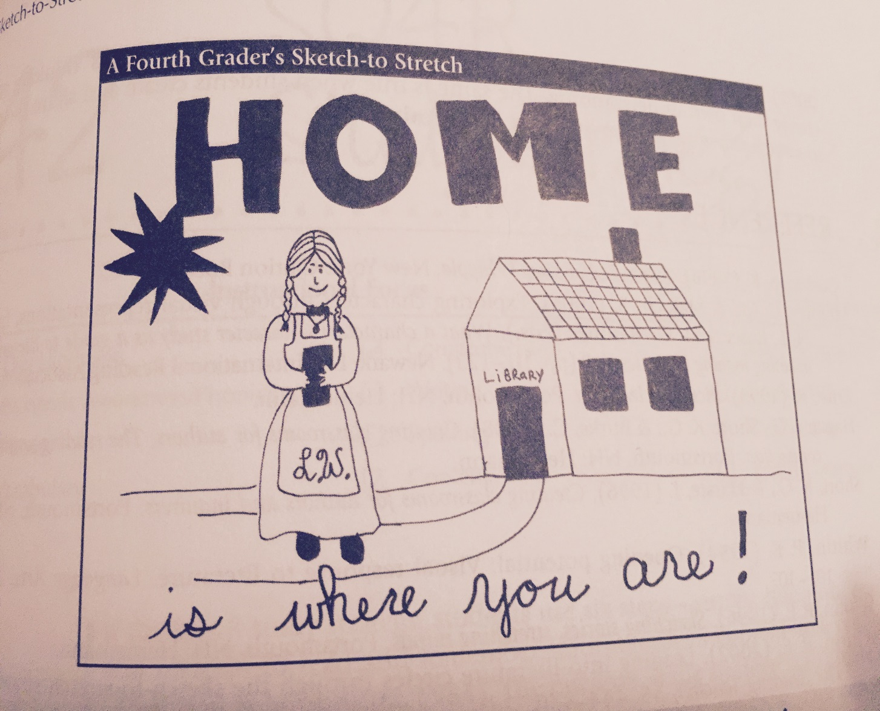
An example.
Now please create your own Sketch to Stretch.
(Tompkins)

Slide 5
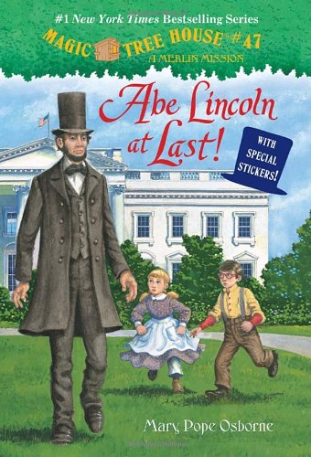
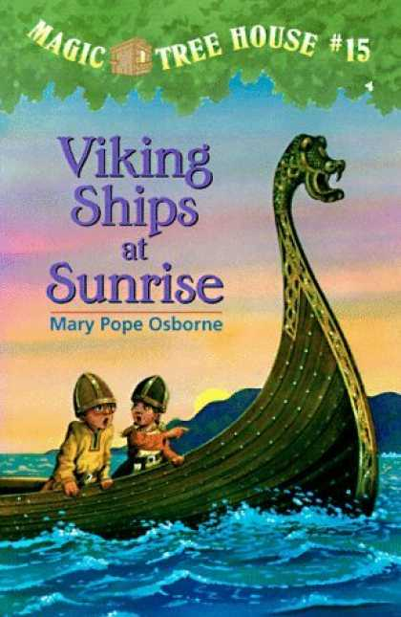
Sketch-to-Stretch
Please read
Abe Lincoln at Last!
Group 1 beginning of the story
Group 2 middle of the story
Group 3 middle of the story
Group 4 conclusion (end) of the story
Step 1
Read and talk about the story with your group.
Step 2
Use symbols that represent the story to you.
Step 3
Draw
Step 4
Share and talk about sketches.
Step 5
Choose one sketch to share with the class.
Step 6
Revise sketch and make final copies.

Slide 6
History
Compare & Contrast
The comparison and contrast text pattern involves pointing out likeness (comparison) and or differences (contrast) among facts, people, events, concepts and so on. (Vacca, Vacca, and Mraz)
Students use Venn diagrams to compare and contrast topics. John Venn invented these diagrams to show relationships between and among things, have two or more overlapping circles. (Tompkins)
Non-Fiction: facts and reality that
Includes biography, history and essays
Fiction: something invented, or imagined; a made-up story

Slide 7
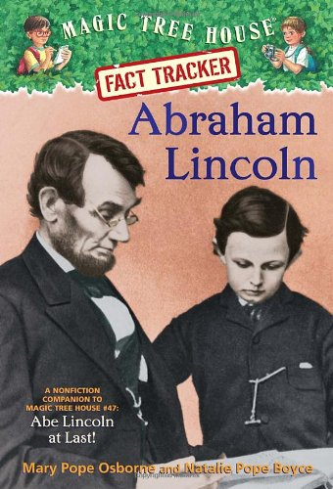
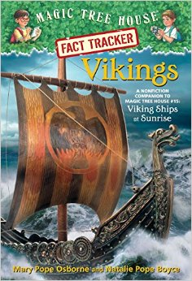
Non-Fiction
Fiction
Step 1:
Students will use this Compare & Contrast Matrix to prewrite details for a writing assignment.
Who
What
When
Where
Why
How

Slide 8
Step 2:
Students will use the Compare & Contrast Matrix from the previous slide to fill-out this graphic organizer. Then students will write 2 paragraphs, and attach them to the matrix.
Compare
How are they alike?
Contrast
How are they different?
fiction
non-fiction

Slide 9
Tableau & Read-Alouds
Hands-On Activity

Slide 10
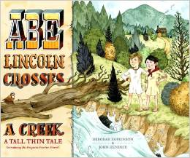
Hands-On Activity
Abe Lincoln Crosses A Creek and Who Was Abraham Lincoln are the two books that will be used in this activity.
The book, Abe Lincoln Crosses A Creek, is historical fiction about two boys and their adventures. I will use this book and have students read the story and then demonstrate their comprehension using a Tableau. I will have students perform a snapshot drama of the various events that take place within the book.
Students will work in groups, and will have 7 minutes to plan their tableau. Then they come together to what we call the playing field. They will attempt to use only gestures to convey their understanding. The group not performing would go to the observation deck. I will say, “Three, two, one and action,” and the group on the playing field would perform their tableau, a group frozen statue, for the rest of the class.
Those students on the observation deck would try to interpret what they are seeing. Next, another group would go to the playing field until all groups have preformed their tableau. I think this is an excellent way to motivate students and engage them in a story.
Abe-Lincoln-Crosses-Creek

Slide 11
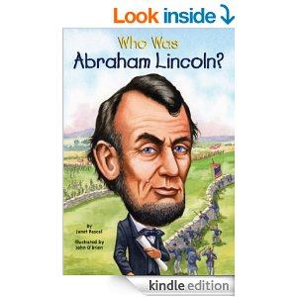
Read-Alouds
I will do a picture walk to introduce the book, Who Was Abraham Lincoln, to activate students’ prior knowledge.
Next, students will listen as I read the story and we will discuss the passage, and they will choose 4 vocabulary words from a list on the board.
Students will choose a vocabulary word in each chapter and share it with their peers at the end of the chapter. Then we will repeat the steps.
We will continue until we are finished with the book and they have created a vocabulary book.
I think this is a great way to engage students while reading a story.
Who Was Abraham Lincoln?

Slide 12
Choose a vocabulary word, while I read the story (chapter) and use it to complete one of these graphic organizers.
picture
sentence
definition
word
definition
example/non-example
picture
sentence

Slide 13
Fold your paper into quadrants, four parts, and place a different vocabulary word in each quadrant. Then use the vocabulary word to complete the graphic organizer in each quadrant.
Your Name
Title of Book Chapter
word
definition
example/non-example
picture
sentence
picture
sentence
definition
picture
sentence
definition
word
definition
example/non-example
picture
sentence

