Slide 1
3rd Grade
Lisa Bays
CI 551

Slide 2
An Author Study of
Chris Van Allsburg

Slide 3
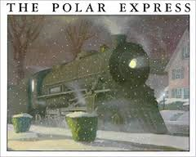
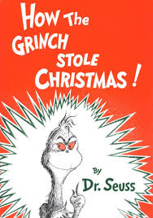
Which of these authors is the most interesting to you? Why? Select your number and cast a vote with a star. Voting 11/15/13
5
Mary Pope Osborne
Chris Van Allsburg
Dr. Seuss
2
8
13
15
21
3
9
10
11
14
16
18
19
6
12
1
4
7
17
Interest Inventory: Student Driven

Slide 4
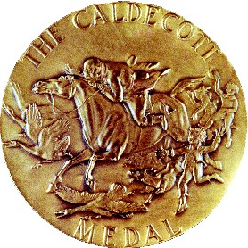
An Author Study Of Chris Van Allsburg!
Regina Medal
Caldecott Medal
Notes:
Regina Medal is given to authors for a life time achievement award.
1999 Eric Carle 1998 Patricia C. and Fredrick L. McKissack 1997 Eve Bunting 1996 Russell Freedman 1995 Gary Paulsen 1994 Lois Lowry 1993 Chris Van Allsburg 1992 Jane Yolen 1991 Leonard Everett Fisher 1990 Virginia Hamilton 1989 Steven Kellogg 1988 Katherine Paterson 1987 Betsy Byars 1986 Lloyd Alexander 1985 Jean Fritz 1984 Madeline L'Engle 1983 Tomie dePaola 1982 Theodor Seuss Geisel 1981 Augusta Baker 1980 Beverly Cleary

Slide 5
CCSS.ELA-Literacy.W.3.3.b Use dialogue and descriptions of actions, thoughts, and feelings to develop experiences and events or show the response of characters to situations.
CCSS.ELA-Literacy.L.3.3.a Choose words and phrases for effect.*
CCSS.ELA-Literacy.W.3.3 Write narratives to develop real or imagined experiences or events using effective technique, descriptive details, and clear event sequences.
CCSS.ELA-Literacy.W.3.3.a Establish a situation and introduce a narrator and/or characters; organize an event sequence that unfolds naturally.
CCSS.ELA-Literacy.SL.3.1.b Follow agreed-upon rules for discussions (e.g., gaining the floor in respectful ways, listening to others with care, speaking one at a time about the topics and texts under discussion).
Common Core State Standards

Slide 6
CCSS.Math.Content.3.MD.B.4 Generate measurement data by measuring lengths using rulers marked with halves and fourths of an inch. Show the data by making a line plot, where the horizontal scale is marked off in appropriate units— whole numbers, halves, or quarters.
CCSS.ELA-Literacy.RST.3-8.5 Analyze the structure an author uses to organize a text, including how the major sections contribute to the whole and to an understanding of the topic.
CCSS.Math.Content.3.MD.B.3 Draw a scaled picture graph and a scaled bar graph to represent a data set with several categories. Solve one- and two-step "how many more" and "how many less" problems using information presented in scaled bar graphs. For example, draw a bar graph in which each square in the bar graph might represent 5 pets.
CCSS.ELA-Literacy.RST.3-8.3 Follow precisely a multistep procedure when carrying out experiments, taking measurements, or performing technical tasks

Slide 7
A Six Week Unit on Chris Van Allsburg’s books:
Polar Express | (Dec.5-19) two weeks
Class: Musical Performance for school | December 19, 2013
Jumanji | (April 21-25)
Zathura | (April 28-May 2)
Two Bad Ants | (May 5-9)

Slide 8
Polar Express
What I know or want learn about the author.
Don’t know who the author is.
What I know about the book.
That it is a book about a little boy who doesn’t believe in Santa.
What I know about the movie.
Learned songs in second grade!
It is funny and true.
Most have watched the movie
Same thing as the book but more exciting.
It has magic!
You have to believe in Christmas!
Where does he live?
What other books has he written?
What does he look like?

Slide 9
Jumanji
What I know about the author.
He has won different medals.
What I know about the book.
This book is adventurous.
Fantasy
What I know about the movie.
3 students have seen the movie.
He wrote The Polar Express.
He is a children’s author.
He is still alive.
The book has many characters.
The name of the game is Jumanji.
It is a real life game that people can play.
Setting is in the city
Game was found at a construction site.
Bats
Jungle
Monkeys
Lion
Spiders
Rhinos
Hunter

Slide 11
Central Question Why do you think Chris Van Allsburg wrote this story? Stem Questions for Jumanji small and large group discussion
What do you do when you are bored? Did you find yourself in trouble?
Have you ever played a game or put something together without reading the instructions? What happened?
What might have happened to Peter and Judy if they had not read the instructions to Jumanji?
What might happen to the Budwing boys? Would you warn them?
Do you think Peter and Judy change as a result of their adventure with Jumanji?
What would be another good title for this story?
http://www.houghtonmifflinbooks.com/features/thepolarexpress/tg/jumanji.shtml

Slide 12
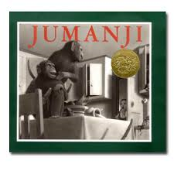
Jumanji
Plot Summary
When Peter and Judy’s parents head to the opera and leave the
children to their own devices for the afternoon, the children’s
excitement quickly turns to boredom. This changes when they find
what appears to be an ordinary board game labeled “Jumanji” sitting
under a tree in the park. A note taped to the box warns them to
read the instructions. Mildly curious, the children take the game
home. When they halfheartedly begin to play, it becomes immediately
apparent that they are dealing with a very unusual game!
With each roll of the dice, the events described by the game
board begin to materialize around them. As the game progresses,
their quiet home is transformed by a hungry lion, a band of mischievous
monkeys, a befuddled guide, a monsoon, a rhinoceros stampede,
and a giant python draped across the mantelpiece. Just as the
children begin to lose hope that their home will ever be quiet
again, Judy wins the game by landing on the square representing
the golden city of Jumanji. In an instant, the house is exactly as it
was before they began playing. Peter and Judy run back to the park,
deposit the game under the tree where they found it, and are fast
asleep when their parents return. Later that evening, they look out
the window and see Danny and Walter Budwing, two children not
known for reading instructions, carrying the box out of the park
toward their home.
Listen and Read along with the book
http://childrensbookalmanac.com/category/animals/page/3/
http://www.houghtonmifflinbooks.com/features/thepolarexpress/tg/jumanji.shtml

Slide 13
Story: Jumanji
Day 1
Unit: Jumanji
Theme: Meet the Author
Lesson: Background information on Chris Van Allsburg
Objective: Students will be able to match vocabulary words to the definition while playing the concentration game. [enormous, opportunity, adventure, opera, gasp, monsoon, hunched, tremendous, splinter, mantel, erupts, molten, exhaustion, nudged, and instructions.]
Strategy: Concentration Game

Slide 14
Smart Board Concentration Game Students will move tile to match up the vocabulary word to its definition. Once they have they will place the tiles and rest tiles at the top of the board.
TEAM 1
Place tiles here
Must be out of slide show mode to play
TEAM 2
Place tiles here
enormous | heavy rain | hunched | directions | exhaustion
opportunity | undertaking | to force out | tremendous | shelf above a fireplace
adventure | catch your breath | splinter | push gently | molten
opera | a good chance | crooked position | mantel | extreme size
gasp | musical composition | faction broken away | liquefied by heat | nudged
monsoon | great in size | erupts | instructions | being very tired

Slide 15
Meet the Author/Chris Van Allsburg
Students will use these packets during guided reading
A peek at Chris Van Allsburg
About the Author
click here must be out of Slide Show mode for PDF file
http://www.teacherspayteachers.com/Store/The-Sweetest-Thing

Slide 16
Story: Jumanji
Day 2
Unit: Jumanji
Theme: The Author’s point of view
Lesson: Persuade, Inform or Entertain (PIE)
Objective: Students will be able to demonstrate understanding of vocabulary words while playing the game. [enormous, opportunity, adventure, opera, gasp, monsoon, hunched, tremendous, splinter, mantel, erupts, molten, exhaustion, nudged, sleeping sickness, and instructions.]
Strategy: Word Play *PASSWORD*

Slide 17
Password
To play the game click on this slide.

Slide 18
Story: Jumanji
Day 3
Unit: Jumanji
Theme: Meet the Author
Lesson: Chris Van Allsburg/ Reader’s Theater
Objective: Students will be able to compare and contrast Jumanji and Polar Express using a Venn diagram.
Strategy: Whatta Ya Know
Students will create the questions.

Slide 19
Venn Diagram
Polar Express
Jumanji

Slide 20
Whatta Ya Know!
Has your imagination gotten you into trouble?
yes
no
Next question
yes
no
Next question
yes
No
Next question

Slide 21
http://kateinelgin.wordpress.com/
Jumanji Reader’s Theater
Mother | Father | Peter | Judy | Guide | Mrs. Budwing
Narrator 1 | Narrator 2 | Narrator 3 | Narrator 4 | Narrator 5 | Narrator 6
Narrator 7 | Narrator 8 | Narrator 9 | Monkey 1 | Monkey 2 | Monkey 3
Lion | Rhino | Rhino | snake | Danny | Walter

Slide 22
Story: Jumanji
Day 4
Unit: Jumanji
Theme: The Author’s point of view
Lesson: Persuade, Inform or Entertain (PIE)
Objective 1: Students will be able to develop sentences using different clues to guess the vocabulary word.
Strategy 1: Twenty Questions
Objective 2: Students will plan, construct, create and develop most of the parts of a play over a span of 3 weeks.
Strategy 2: Readers Theater.

Slide 23
Twenty Questions Authors Point of view
Enormous
Opportunity
Adventure
Opera
Gasp
Monsoon
Hunched
Tremendous
Splinter
Mantel
Erupts
Molten
Exhaustion
Nudged
Instructions
http://facebook.com/sweetntegrations1

Slide 24
Story: Jumanji
Day 5
Unit: Jumanji.
Theme: Rules, rules, and more rules.
Lesson: Invent your own game.
Objective 1: Students will create their own board game.
Strategy 1: Demonstrate knowledge through hands on creation.
Objective 2: Students will construct definitional sentences using vocabulary words.
Strategy 2: Stump The Expert.
Objective 3: Map out word cloud.
Strategy 3: Play with words.

Slide 25
Stump The Expert Students will be in groups of 5 the EXPERT will give the clue in a sentence and the students will give clues from one student to the next. Who ever gives the correct answer becomes the new EXPERT. Good Luck and Beat the clock!
Timer
Enormous
Opportunity
Adventure
Opera
Gasp
Monsoon
Hunched
Tremendous
Splinter
Mantel
Erupts
Molten
Exhaustion
Nudged
Instructions

Slide 26
Invent your own game
http://facebook.com/sweetntegrations1

Slide 27
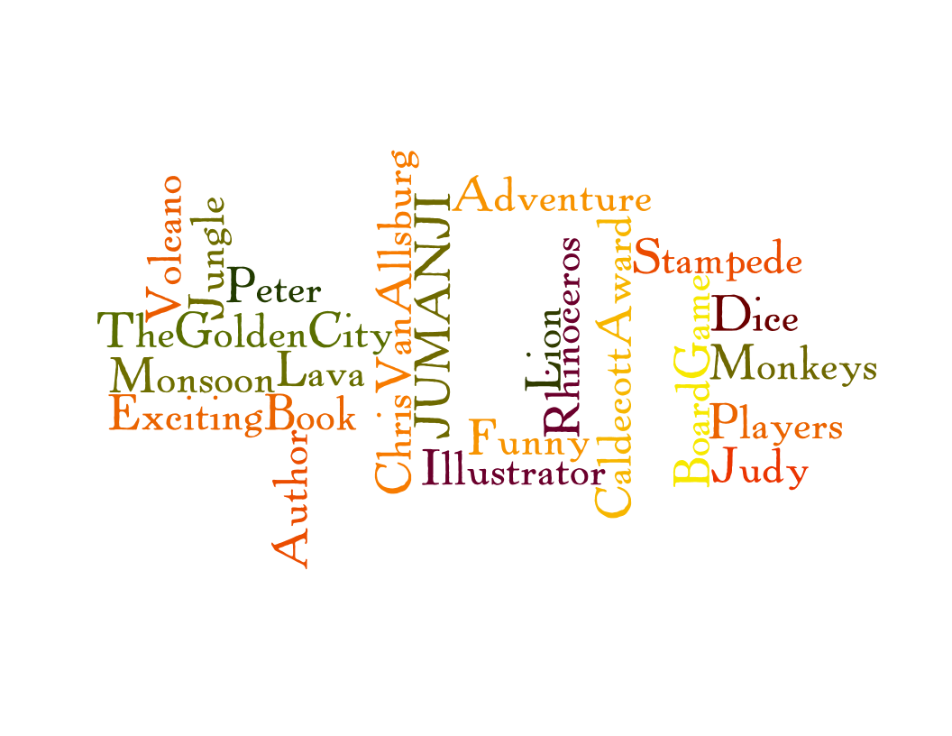
Wordle http://www.wordle.net/create
Students will create a wordle using at least 10-12 descriptive words from the book.
JUMANJI
ChrisVanAllsburg
BoardGame
ExcitingBook
Funny
Stampede
Volcano
Jungle
Lion
Dice
Monsoon
Rhinoceros
Monkeys
Adventure
Lava
Author
Illustrator
CaldecottAward
Peter
Judy
Players
TheGoldenCity

Slide 28
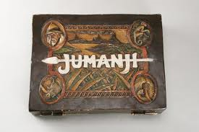
Jumanji Movie on Friday
Students will present and play the board games they invented

Slide 29
Jumanji Class Play Presentation
Sorry too large to import movie into the PowerPoint, although each child received a DVD.

Slide 30
Bibliography
http://jacksspot.wordpress.com/
http://www.houghtonmifflinbooks.com/features/thepolarexpress/tg/jumanji.shtml
http://www.huffingtonpost.com/epicurious/a-ihow-the-grinch-stole-c_b_4386084.html
http://www.teacherspayteachers.com/Store/The-Sweetest-Thing
http://www.scottsboro.org/~flewis/SF%20Reading%20Street/Third%20Grade%20Reading%20Street%20Teacher%20Resources.htm
http://facebook.com/sweetntegrations1
http://kateinelgin.wordpress.com
http://www.wordle.net/create
Moore, D. W., Moore, S. A., Cunningham, P. M., & Cunningham, J. W. (2011). Developing Readers and Writers in the Content Areas K-12. Boston: Pearson.
Van Allsburg, C. (1981). Jumanji. New York: Houghton Mifflin Harcourt Publishing Company.

Slide 31
Zathura next week

