Slide 1
Strategies notebook
By Lisa Bays
3rd Grade
English Language Arts

Slide 2
1. Vocabulary Triangles
I used this strategy in my classroom with the book, The Story of the Statue of Liberty. In the past, students had difficulty with using the vocabulary words from the story in conversation. One of the most positive aspects of this strategy was that students were able to discuss the meaning of the words and were able to figure out how to use it in a sentence.
If I were to pick a negative aspect of this strategy, it would be that it took 40 minutes for the students to complete the activity. This strategy is similar to Sematic Feature Analysis, because the students have to look closely at the vocabulary word’s attributes and the their relationship with each other. The following slides is how I used it in class.

Slide 3
Vocabulary Triangles This was the first lesson with the Vocabulary Triangles and it consisted of me scaffolding the students. LESSON: Let’s look at a few examples. On this slide we will see words that are in our story this week. We will do an oral writing lesson using words from the story, Suki’s Kimono. The next story you will create your own Vocabulary Triangles and write it on paper.
cotton
festival
handkerchief
The festival had many
floats in the parade that
used cotton.
The festival that was at our town,
was a place to buy red, white and blue handkerchiefs,
that were made from 100% cotton.
The handkerchief was made of cotton, that the clown waved at the bull.
The tall, skinny cowboy carried a red handkerchief in his back right pocket at the fall festival.
(Vacca, Vacca, & Mraz)

Slide 4
Create new sentences using two words in the triangle. After creating three sentences with two words. Create the last sentence using all three words. Use three of your vocabulary words in our story, The Story of the Statue of Liberty.
Liberty
symbol
Torch

Slide 5
2. Magic Square
“An activity sheet has two columns, one for terms and one for definitions. Students are directed to match terms to definitions. In doing so, they must take into account the letters representing the terms and the numbers representing the definitions. The students then put the number of the definitions in the proper space in the magic square answer box. If their answers are correct they will form a magic square. That is, the numerical total will be the same for each row across and each column down the answer box. The total forms the puzzles magic number.” (Vacca, Vacca, & Mraz)

Slide 6
I used the Magic Square strategy with the story, Suki’s Kimono. In the beginning, the students had difficulty understanding this concept. So they practiced the words with a partner, and then they really started to understand and like it. The next time we use this strategy I think they will be able to accomplish it on paper. One of the positive aspects is that the students have been wanting to do this activity again. One of the negative aspects of this activity is that it takes a lot of time for the teacher to design the lesson. This strategy is similar to Vocabulary Triangle and SFA because students have to be able to differentiate between the words to be successful. This next slide is what we used.

Slide 7
word bank definitions
cotton
festival
graceful
Handkerchief
paces
pale
rhythm
Snug
approve
1. a program of entertainment often held annually
2. the natural strong beat that some music or poetry has
3. not bright; dim
4. to think well of something; to favor something
5. steps
6. cloth made from soft, white fibers that grow in branches on the cotton plant
7. a soft, usually square piece of cloth used for wiping your nose, face, or hands
8. beautiful in form or movement
9. fitting your body closely

Slide 8
Magic Squares
7
2
9
5
8
3
4
1
6

Slide 9
With your paper make your magic squares by folding your paper.
Magic Square Answers
a
d
g
h
e
b
c
f
i

Slide 10
3. Quilt Strategy
“Students will make quilt squares to extend their comprehension and to celebrate a story that they have read or a topic that they have study” (Tompkins)
My students used the Quilt Strategy with Me and Uncle Romie. I placed students into groups and they read a specific section of the story. Then I had them sit down and illustrate their section of the story on a quilt block. This strategy is one that the students liked the most. Students were delving very deeply into the text, looking for details to support their illustrations. I really can’t think of a negative aspect of this strategy. It didn’t take long or require much preparation and the students loved it. This strategy is similar to Open-Minded Portraits because they are looking very closely at details within the story.

Slide 11
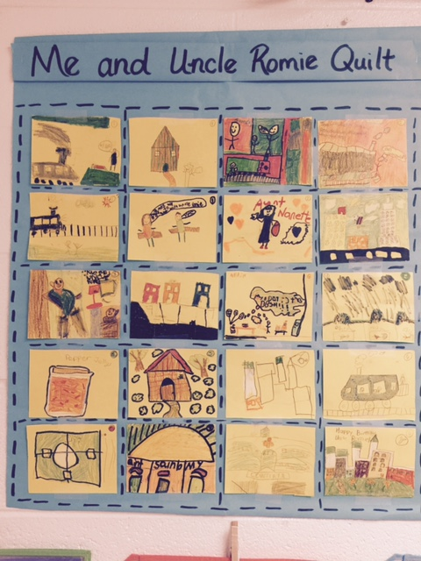
Click here

Slide 12
4. Open-Mind Portrait Strategy
Click here
To think more deeply about the character and reflect on story events from the character’s viewpoint, students draw open-mind portraits of the character. (Vacca, Vacca, and Mraz)
The students and I discussed the main characters in the story, Me and Uncle Romie. Then we talked about several different attributes the characters displayed through out the story. While the students were drawing their portraits, they were laughing and emotionally connected to the story. This engagement would be the positive aspect of the activity. The negative aspect of this activity was that the students were hesitant to begin the activity. Their hesitancy was due to apprehension that their drawing skills might be inadequate. Although, once they started drawing they enjoyed the lesson. This story is similar to Quilt in the way that it has the students look close to the events and characters in the story.

Slide 13
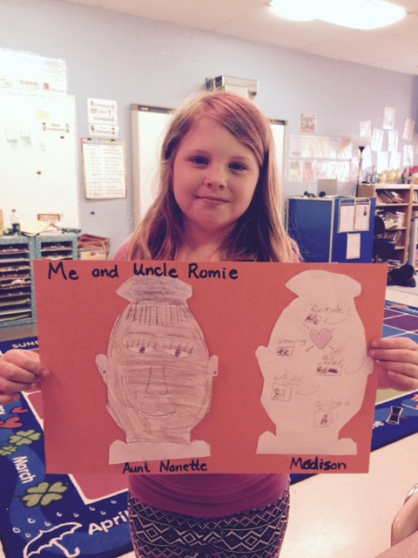
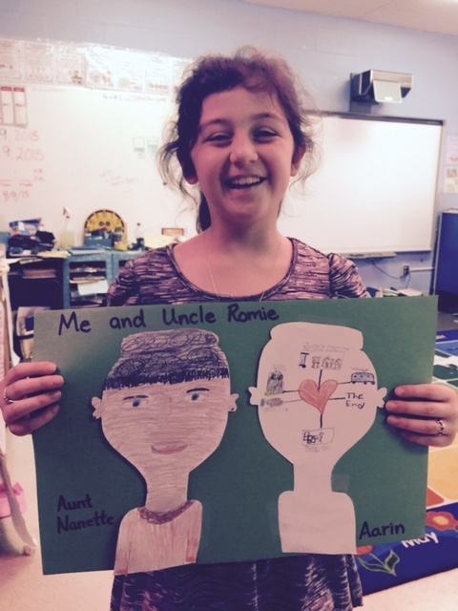
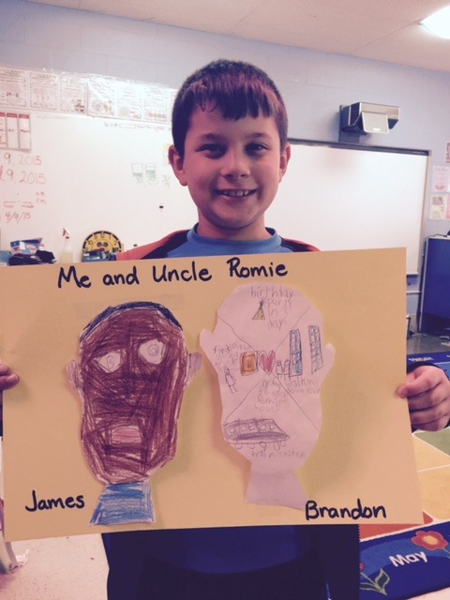
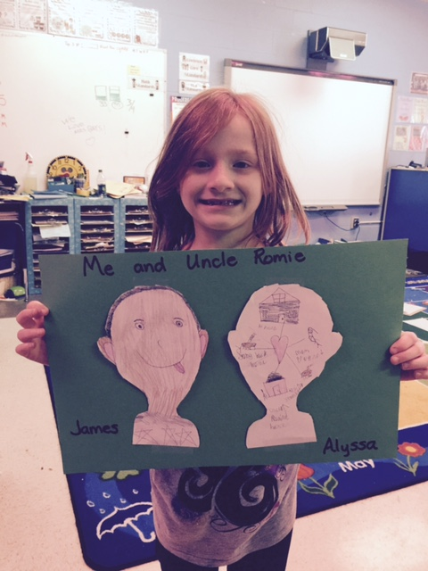
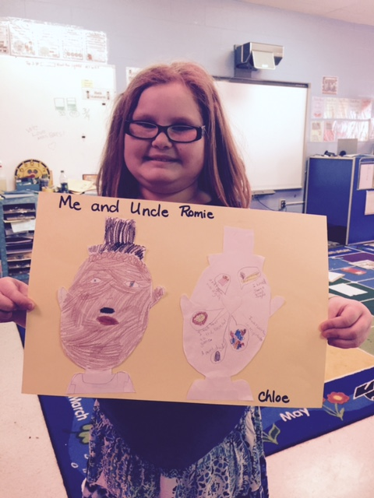

Slide 14
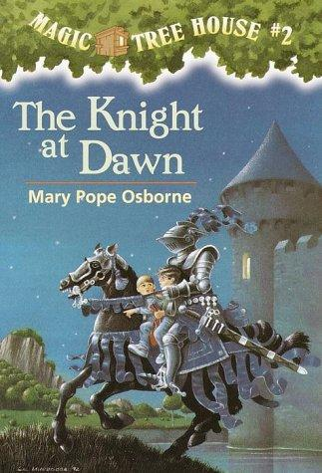
5. Point of View Guide (POVG)
“POVG’s are designed to trigger thoughtful reading and writing by having students “get inside the skin” of a character or a subject under study.” (Vacca, Vacca, & Mraz)
I have used POVGs by having students act out a chapter in The Knight at Dawn. There are many positive aspects to using this strategy. When students play a character that they have read about, they discuss why they are going to act a specific way. They will refer back to the text and say something like “well the author wrote that Jack was hesitant before falling from the precipice, so he had to feel scared, brave and worried all at the same time.” The student playing Jack said, “that is the way that I see it playing in my head.” When students are able to connect to the text, they will write more vividly. One of the negative aspects is the amount of time that it takes to complete this activity. For example, I spent two weeks on this lesson.

Slide 16
Strategy Notebook Lisa, You did a FABULOUS job with this project. Your PowerPoint is excellent. It is very colorful and eye-catching as well. You did a wonderful job explaining each of the strategies and providing examples to illustrate them. The smiling faces of the children in the photos are a demonstration of how much your students enjoyed working with the strategies too. The student examples are the most powerful indicator of your success with the strategies...The proof that the strategies work. Your project is an example of the kind of literacy instructional leadership the Literacy Education Program faculty expects to see from our students. I want to encourage you to hang on to this project and realize that it is a demonstration of your skill and knowledge set and shows how you have mastered various International Literacy Standards. This would be a useful resource to have / use in an in-service for other teachers. I just received another notice about the WV Reading Conference regarding the submission for program proposals. Just saying...You need to consider doing a presentation. Thank you, IWL

