Slide 1
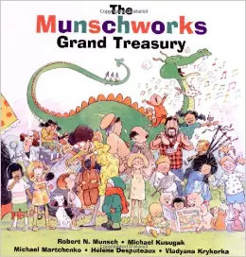
Figurative Language
Thematic Literacy Project
By: Lisa Bays
CIRG 644

Slide 2
Introductory Activity
Alliteration
Figurative Language
Onamonapia
Materials
Materials
Evaluation
Students will do a Web Quest
Semantic
Map
Books:
Pigs
Something Good
Purple, Green and Yellow
Books:
The Paper Bag Princess
Stephanie’s Pony Tail
Paper
Pencils
Crayons
Scissors
PowerPoint
Paper
Crayons
pencils
Culminating Activity
Evaluation
Students will create a graphic organizer with 4 squares, representing 2 figurative language words and give examples.
Strategies
Strategies
Formative assessment
Quiz &
Rubric
Formative
Assessment
Rubric
KWL Chart
Web Quest
Sketch to Stretch
Venn Diagram
Vocabulary
Triangle
Compare & Contrast Matrix

Slide 3
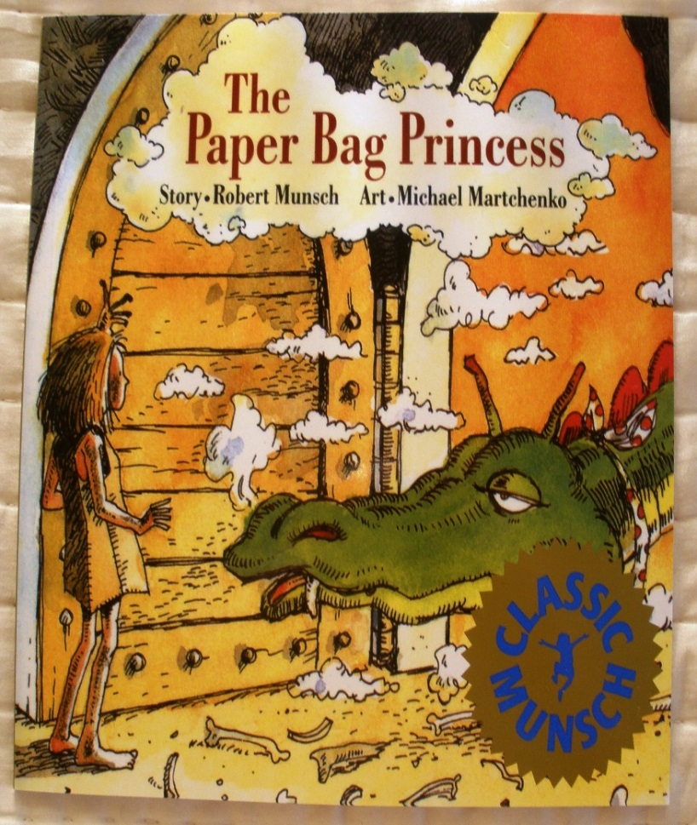
Lesson 1
Objective
LESSON OBJECTIVE:
As a whole group, the 3rd grade students will discuss what they KNOW and WANT know about figurative language, and place it on the KWL Chart.
Then students will explore the web quest strategy on Zunal figurative language, and investigate the two examples of figurative language.
Students will watch and listen to The Paper Bag Princess, an interactive story on Tumble Books from the web quest.
Students will then demonstrate their understanding of 2 types of figurative language with a definition, sentence with an example with illustrations.

Slide 4
1. Students will talk in small groups and discuss what they already know about figurative language.
2. Students will share with the whole group their answers, and the teacher will record their answers on the KWL Chart PowerPoint. (the KW parts)
3. Students will go to the computer lab and explore the web quest.
4. Students will watch and listen to figurative language video’s as well as The Paper Bag Princess story on the web quest.
5. If students finish up early, they can explore other stories by Robert Munsch.
Lesson 1
Procedure

Slide 5
6. Students will take notes as they find examples of Onamonapia and Alliterations during their web quest, and bring them back to the classroom to finish their graphic organizer.
7. Students will discuss their examples with their peers at their table.
8. Students will present their paper to the class and then display their work out in the hall.
9. We will discuss, share and write what we have learned on the KWL chart.
10. Students will use the rubric to understand what is expected of them to.
Lesson 1
Procedure

Slide 6
KWL Chart
Know
Want
Learn

Slide 7
Lesson 1
Assessment
Figurative Language Rubric | 1 point Beginning | 2 points Developing | 3 points Very Good | 4 points Exemplary | Total
Written vocabulary word | Student has 1 figurative language vocabulary labeled but hard to read. | Student has 1 figurative language vocabulary word labeled. | Student has 2 figurative language vocabulary words labeled. | Student has 2 figurative language vocabulary words labeled neatly.
Examples of figurative language vocabulary words | Students have given 1 example with an illustration that matches the vocabulary word. | Students have given 2 examples with illustrations that match the vocabulary words. | Students have given 2 neat examples with colored illustrations that match the vocabulary words. | Student has given 2 very neat examples with colored illustrations that match the vocabulary words.
Shared with a classmate | Student has explained to 2 classmates what the vocabulary words means but need a lot of help. | Student has explained to 2 classmates what the vocabulary words means but needs a little help. | Student has explained to 2 classmates what the vocabulary words means with accuracy. | Student has explained to 3 or more classmates what the vocabulary words means with accuracy.
Lesson Learner Objective | Exceeds Expectations | Meets Expectations | Approaching Expectations | Far Below Expectations
As a group, the 3rd grade students will complete the (K W) part on the KWL chart. Also, students will explore the web quest and give 4 examples, two example of onomatopoeias and two of alliterations. They will give the definition and illustrations on a graphic organizer. | The student has listed 6 or more examples on the graphic organizer. Three examples of Onomatopoeia and Three examples of Alliterations with definitions. Sentences and illustrations are very neatly illustrations. | The student has listed at least 4 examples on the graphic organizer. two examples of Onomatopoeia and two examples of Alliterations with definitions, sentences and neatly illustrations. | The student has listed at least 2 examples on the graphic organizer. Two examples of Onomatopoeia and two examples of Alliterations with definitions, sentence and illustrations. | The student has listed at least 1 examples to place on the graphic organizer. One example of Onomatopoeia and Alliterations with definitions, sentence and illustrations messy.
Formative Assessment – 10 Question Quiz on Tumble Books
Formative Assessment- Rubric on web quest
Summative Assessment- Teacher assisting and assessing with the assignment during the computer lab and classroom work.

Slide 8
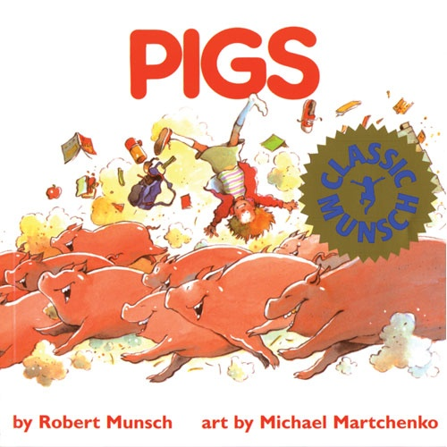
Lesson 2
Objective
LESSON OBJECTIVE:
As a whole group, setting on the carpet, the 3rd grade students will listen and read the story Pigs.
Students will demonstrate their favorite part of the story with a Sketch to Stretch activity, they will talk about any figurative language in the story and include it in the illustration.

Slide 9
Lesson 2
Procedure
Students will have a copy of the story Pigs, by Robert Munsch.
The students will be sitting on the carpet and participate in a picture walk.
Students will make predictions about what they think the story will be about.
The students will listen to part of the story, during a read aloud students will talk to a partner and make an inference of the story, and decide if the will change or keep the prediction with a partner.

Slide 10
Lesson 2
Procedure
The students will continue reading the rest of the story as a group and start discussing what they like best about the story.
Then they will use the Sketch-to-Stretch strategy – and students will follow the 6 steps on the next slide.
Students will return to their seats and work on their sketch.
Students will share and present their finished work.

Slide 11
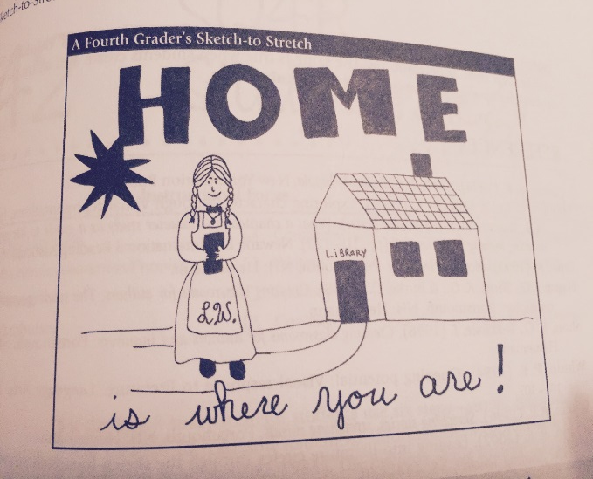
Sketch-to-Stretch
Please read
Pigs!
Step 1
Read and talk about the story with your group.
Step 2
Use symbols that represent the story to you.
Step 3
Draw
Step 4
Share and talk about sketches.
Step 5
Choose one sketch to share with the class.
Step 6
Revise sketch and make final copies.

Slide 12
Lesson 2
Assessment
Lesson 2
Assessment
Lesson Learner Objective | Exceeds Expectations | Meets Expectations | Approaching Expectations | Far Below Expectations
As a group, the 3rd grade students will complete the 6 steps in the Sketch to Stretch activity, represent 1 to 2 items drawn and to place in each section of the diagram and has listed more than 3 or 4 book titles from which they got their examples. | The student has listed at least 2 examples to place in each section of the diagram and has listed more than 3 book titles from which they got their examples. | The student has listed at least 2 examples to place in each section of the diagram and has listed more than 2 book titles from which they got their examples. | The student has listed at least 1 examples to place in each section of the diagram and has listed more than 2 book titles from which they got their examples. | The student has listed at least 1 examples to place in each section of the diagram and has listed more than 1 book titles from which they got their examples.

Slide 13

Lesson 3
Objective
LESSON OBJECTIVE:
As a whole group, the 3rd grade students will explore the web and find a new figurative language hyperbole and investigate what it means.
Then students will watch and hear an interactive story, on Tumble Books. Students will demonstrate with 2 examples of each one of the three figurative languages useing the Venn diagram strategy.

Slide 14
Lesson 3 Procedure
After learning about hyperbole, Students will distinguished and identify three types of the figurative language.
As a whole group, students will use a Venn Diagram to talk, listen, and write down examples of each of the figurative language types on the Venn Diagram located on the next slide.
The students will draw their own Venn diagram on their papers and give at least 3 examples in each section, hyperbole, onomatopoeia, and alliteration.
The students will then find a partner to share their examples with. This will help them to check their work against the rubric to make certain that they have the examples in the correct portion of the Venn diagram and are complying with the rubric.

Slide 15
Figurative Language
Hyperbole
Alliteration
Onamonapia

Slide 16
Lesson 3 Assessment
Lesson Learner Objective | Exceeds Expectations | Meets Expectations | Approaching Expectations | Far Below Expectations
As a group, the 3rd grade students will demonstrate with 2 examples of each one of the 3 figurative languages on the Venn diagram strategy, totaling 6 Students will refer and neatly write down answers on graphic organizer. Students will use the text in the 5 stories to support their answers. | The students will demonstrate with 3 examples of each one of the 3 figurative languages on the Venn diagram strategy, totaling 9. Students will refer and neatly write down answers on graphic organizer. Students will use the text in the 5 stories to support their answers. | The students will demonstrate with 2 examples of each one of the 3 figurative languages on the Venn diagram strategy, totaling 6. Students will refer and neatly write down answers on graphic organizer. Students will use the text in 4 stories to support their answers. | The students will demonstrate with 1-2 examples of each one of the 3 figurative languages on the Venn diagram strategy, totaling 5. Students will refer and write down answers on graphic organizer. Students will use the text in 3 stories to support their answers. | The students will demonstrate with 1 examples of each one of the 3 figurative languages on the Venn diagram strategy, totaling 3. Students will refer and neatly write down answers on graphic organizer. Students will use the text in the 2 stories to support their answers.
Lesson Learner Objective | Exceeds Expectations | Meets Expectations | Approaching Expectations | Far Below Expectations
As a group, the 3rd grade students will complete the Venn Diagram listed at least 3 examples to place in each section of the diagram and has listed more than 3 or 4 book titles from which they got their examples. | The student has listed at least 2 examples to place in each section of the diagram and has listed more than 3 book titles from which they got their examples. | The student has listed at least 2 examples to place in each section of the diagram and has listed more than 2 book titles from which they got their examples. | The student has listed at least 1 examples to place in each section of the diagram and has listed more than 2 book titles from which they got their examples. | The student has listed at least 1 examples to place in each section of the diagram and has listed more than 1 book titles from which they got their examples.

Slide 17
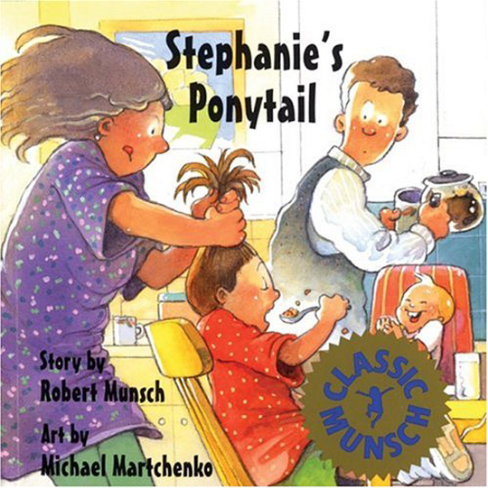
Lesson 4
Objective
LESSON OBJECTIVE:
As a whole group, the 3rd grade students will listen to and read aloud the story Stephanie’s Ponytail.
Then students will use a vocabulary triangle strategy to create 4 completes sentence using the vocabulary words.

Slide 18
Lesson 4 Procedure
The students, in a whole group, will listen to and read aloud the story Stephanie’s Ponytail.
Then students will use a vocabulary triangle strategy.
Students will create 4 completes sentence using the vocabulary words.
Students will find words in the text that they didn’t know and make a list of those words. They will find at least 6 words for a vocabulary list.
Students will place 1 word on each the of triangle’s vertices.
At each end point the student will use that word and one of the words that are connected using those two words in a sentence. Repeating this until students have completed three sentences.
The fourth sentence students will be using all three words in one sentence. See next slide for an example.

Slide 19
seeking
groceries
healthy
1st sentence using both words
2nd sentence using both words
4th sentence using three words
4th sentence using three words
3rd sentence using both words

Slide 20
Lesson 4 Assessment
Lesson Learner Objective | Exceeds Expectations | Meets Expectations | Approaching Expectations | Far Below Expectations
As a group, the 3rd grade students will complete the Venn Diagram listed at least 3 examples to place in each section of the diagram and has listed more than 3 or 4 book titles from which they got their examples. | The student has listed at least 3 examples to place in each section of the diagram and has listed more than 3 book titles from which they got their examples. | The student has listed at least 2 examples to place in each section of the diagram and has listed more than 2 book titles from which they got their examples. | The student has listed at least 1 examples to place in each section of the diagram and has listed more than 2 book titles from which they got their examples. | The student has listed at least 1 examples to place in each section of the diagram and has listed more than 1 book titles from which they got their examples.

Slide 21

Lesson 5
Objective
LESSON OBJECTIVE:
With a partner, the students will individually read the story and then retell the story to their partner.
The students will use a compare & contrast matrix strategy for the stories that were read this week.
Students will include examples that they have learned about figurative language on the (L) on KWL Chart.

Slide 22
Lesson 5 Procedure
With a partner the students will read the story Purple, Green and Yellow, and retell the story to their partner.
Students will search for figurative language in the story and write down any examples that they find.
The teacher will scaffold how to use the matrix by entering examples.
The teacher will give the graphic organizer from the next slide to the students.
Students will use the next slide to enter data on the compare and contrast matrix.
The students will use the compare & contrast matrix strategy for the stories that they read this week.
Students will include examples that they have learned about figurative language on the (L) on KWL Chart.

Slide 23
Compare and Contrast Matrix
Compare
How are they alike?
Contrast
How are they different?

Slide 24
Lesson 5 Assessment
Lesson Learner Objective | Exceeds Expectations | Meets Expectations | Approaching Expectations | Far Below Expectations
As a group, the 3rd grade students will demonstrate with 2 examples of each one of the 3 figurative languages on the Compare & Contrast strategy, totaling 6. Students will refer and neatly write down answers on graphic organizer. Students will use the text in the 5 stories to support their answers. | The students will demonstrate with 3 examples of each one of the 3 figurative languages on the Compare & Contrast strategy, totaling 9. Students will refer and neatly write down answers on graphic organizer. Students will use the text in the 5 stories to support their answers. | The students will demonstrate with 2 examples of each one of the 3 figurative languages on the Compare & Contrast strategy, totaling 6 Students will refer and neatly write down answers on graphic organizer. Students will use the text in the 5 stories to support their answers. | The students will demonstrate with 2 examples of each one of the 2 figurative languages on the Compare & Contrast strategy, totaling 4 Students will refer and neatly write down answers on graphic organizer. Students will use the text in the 4-3 stories to support their answers. | The students will demonstrate with 1 examples of each one of the 3 figurative languages on the Compare & Contrast strategy, totaling 3. Students will refer and neatly write down answers on graphic organizer. Students will use the text in the 3-2 stories to support their answers.

