Slide 1
What is a sundial?

Slide 2
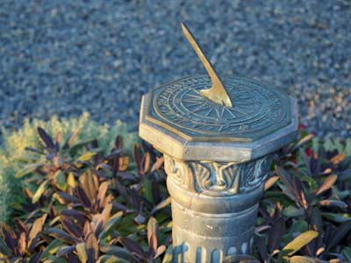
What is a sundial? Who used them? Why did they use them? We will create a sundial and learn how to use it!
What I Know
What I Want to learn
What I have Learned

Slide 3
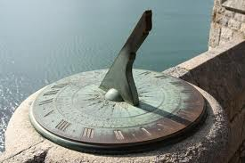
Fun in the Sun A Sundial Tutorial
http://qwerty.co.za/sundials/index.html

Slide 4
Sundial Instruction and template.
Instructions
Print the template on a sheet of oak tag paper.
Cut out the two circles and the main body of the dial.
Gently score the dotted lines.
Fold along the dotted lines.
Glue the flaps.
Gently push a kebab stick or other suitable rod (the gnomon) through the centers of the circles.
Go outside, align your model and tell the time.
Download the template polardial.pdf.

